Slide 1
Chapter 13 C Preprocessor

Slide 2
13.1 Introduction
The C preprocessor executes before a program is compiled.
Some actions it performs are the inclusion of other files in the file being compiled, definition of symbolic constants and macros, conditional compilation of program code and conditional execution of preprocessor directives.
Preprocessor directives begin with # and only whitespace characters and comments may appear before a preprocessor directive on a line.

Slide 3
13.2 #include Preprocessor Directive
The #include preprocessor directive has been used throughout this text.
The #include directive causes a copy of a specified file to be included in place of the directive.
The two forms of the #include directive are:
#include <filename> #include "filename"
The difference between these is the location the preprocessor begins searches for the file to be included.
If the file name is enclosed in quotes, the preprocessor starts searches in the same directory as the file being compiled for the file to be included (and may search other locations, too).

Slide 4
13.2 #include Preprocessor Directive (Cont.)
This method is normally used to include programmer-defined headers.
If the file name is enclosed in angle brackets (< and >)—used for standard library headers—the search is performed in an implementation-dependent manner, normally through predesignated compiler and system directories.

Slide 5
13.2 #include Preprocessor Directive (Cont.)
The #include directive is used to include standard library headers such as stdio.h and stdlib.h (see Fig. 5.10) and with programs consisting of multiple source files that are to be compiled together.
A header containing declarations common to the separate program files is often created and included in the file.
Examples of such declarations are structure and union declarations, enumerations and function prototypes.

Slide 6
13.3 #define Preprocessor Directive: Symbolic Constants
The #define directive creates symbolic constants—constants represented as symbols—and macros—operations defined as symbols.
The #define directive format is
#define identifier replacement-text
When this line appears in a file, all subsequent occurrences of identifier that do not appear in string literals will be replaced by replacement-text automatically before the program is compiled.

Slide 7
13.3 #define Preprocessor Directive: Symbolic Constants (Cont.)
For example,
#define PI 3.14159
replaces all subsequent occurrences of the symbolic constant PI with the numeric constant 3.14159.
Symbolic constants enable you to create a name for a constant and use the name throughout the program.
If the constant needs to be modified throughout the program, it can be modified once in the #define directive.
When the program is recompiled, all occurrences of the constant in the program will be modified accordingly.

Slide 8
13.3 #define Preprocessor Directive: Symbolic Constants (Cont.)
Everything to the right of the symbolic constant name replaces the symbolic constant.] For example, #define PI = 3.14159 causes the preprocessor to replace every occurrence of the identifier PI with = 3.14159.
This is the cause of many subtle logic and syntax errors.
For this reason, you may prefer to use const variable declarations, such as
const double PI = 3.14159;
in preference to the preceding #define. Redefining a symbolic constant with a new value is also an error.

Slide 9
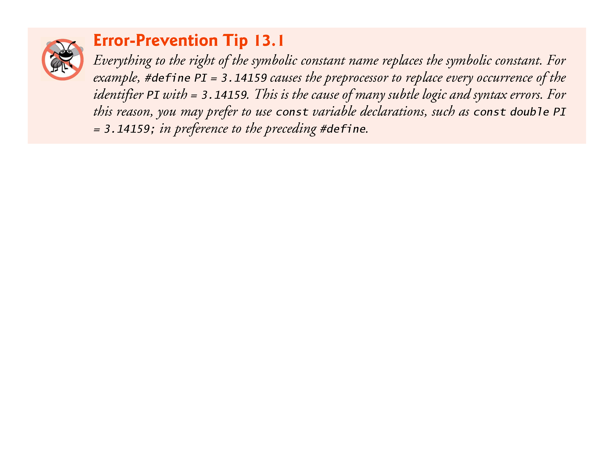

Slide 10
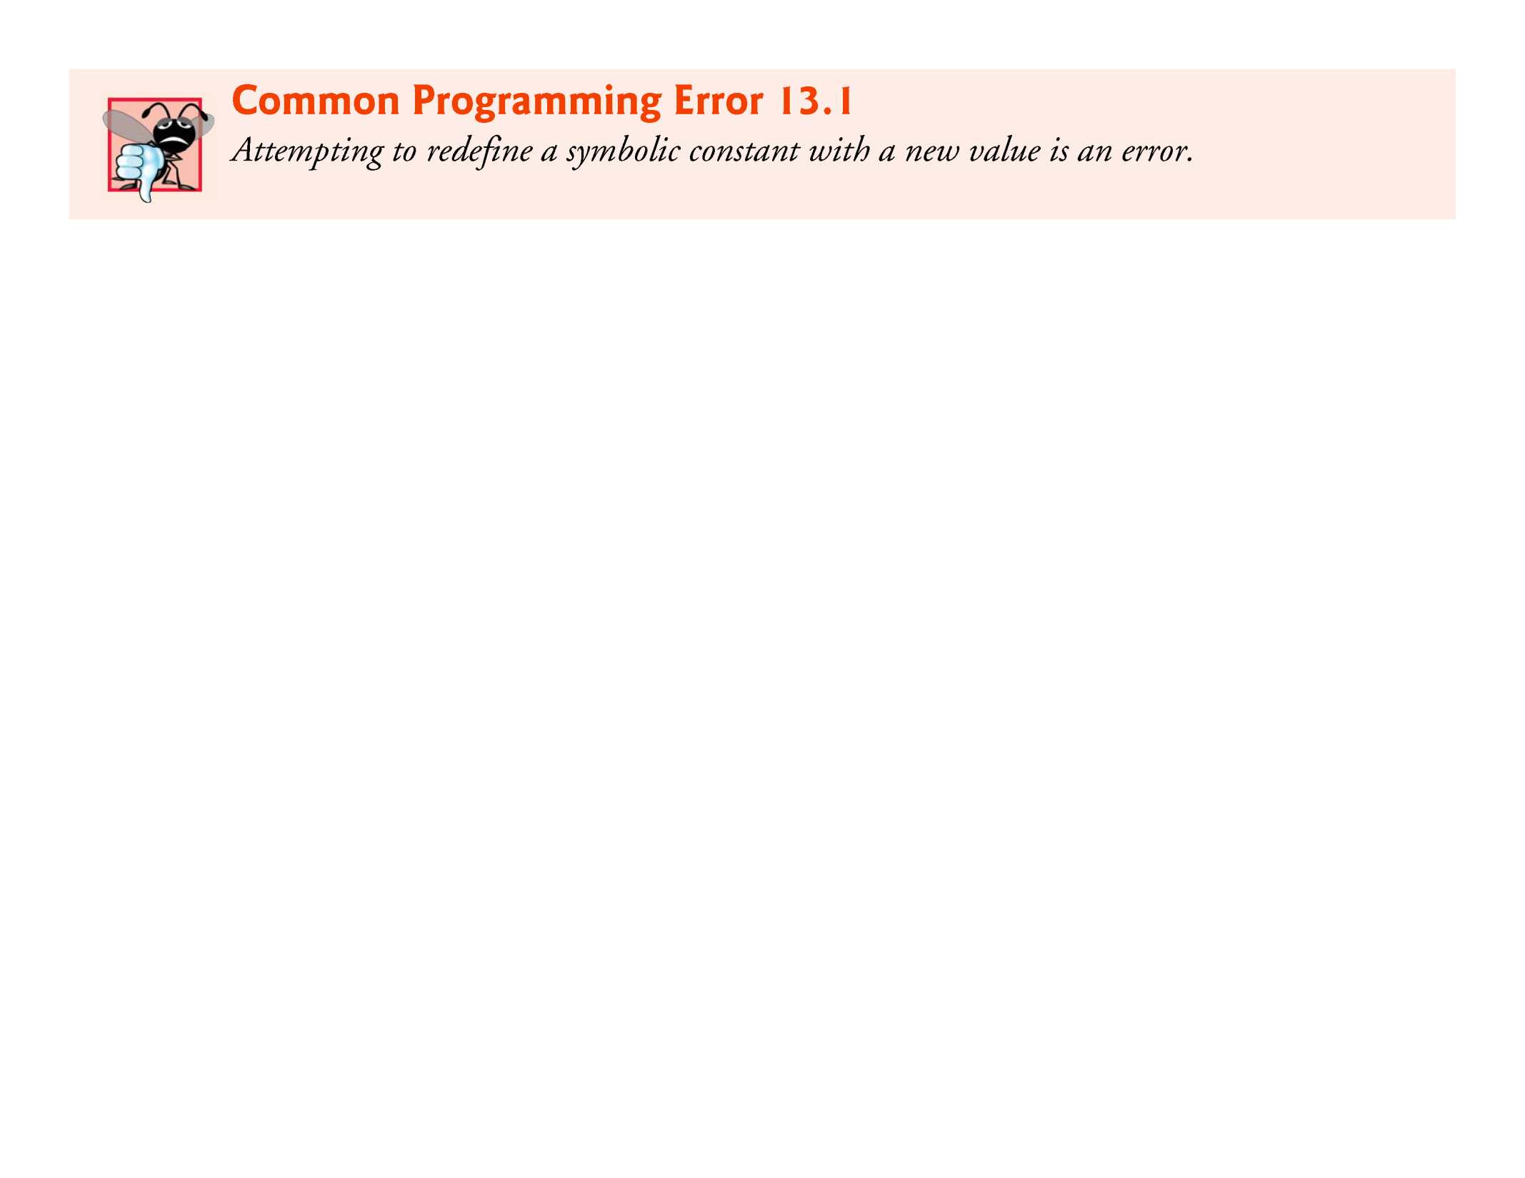

Slide 11
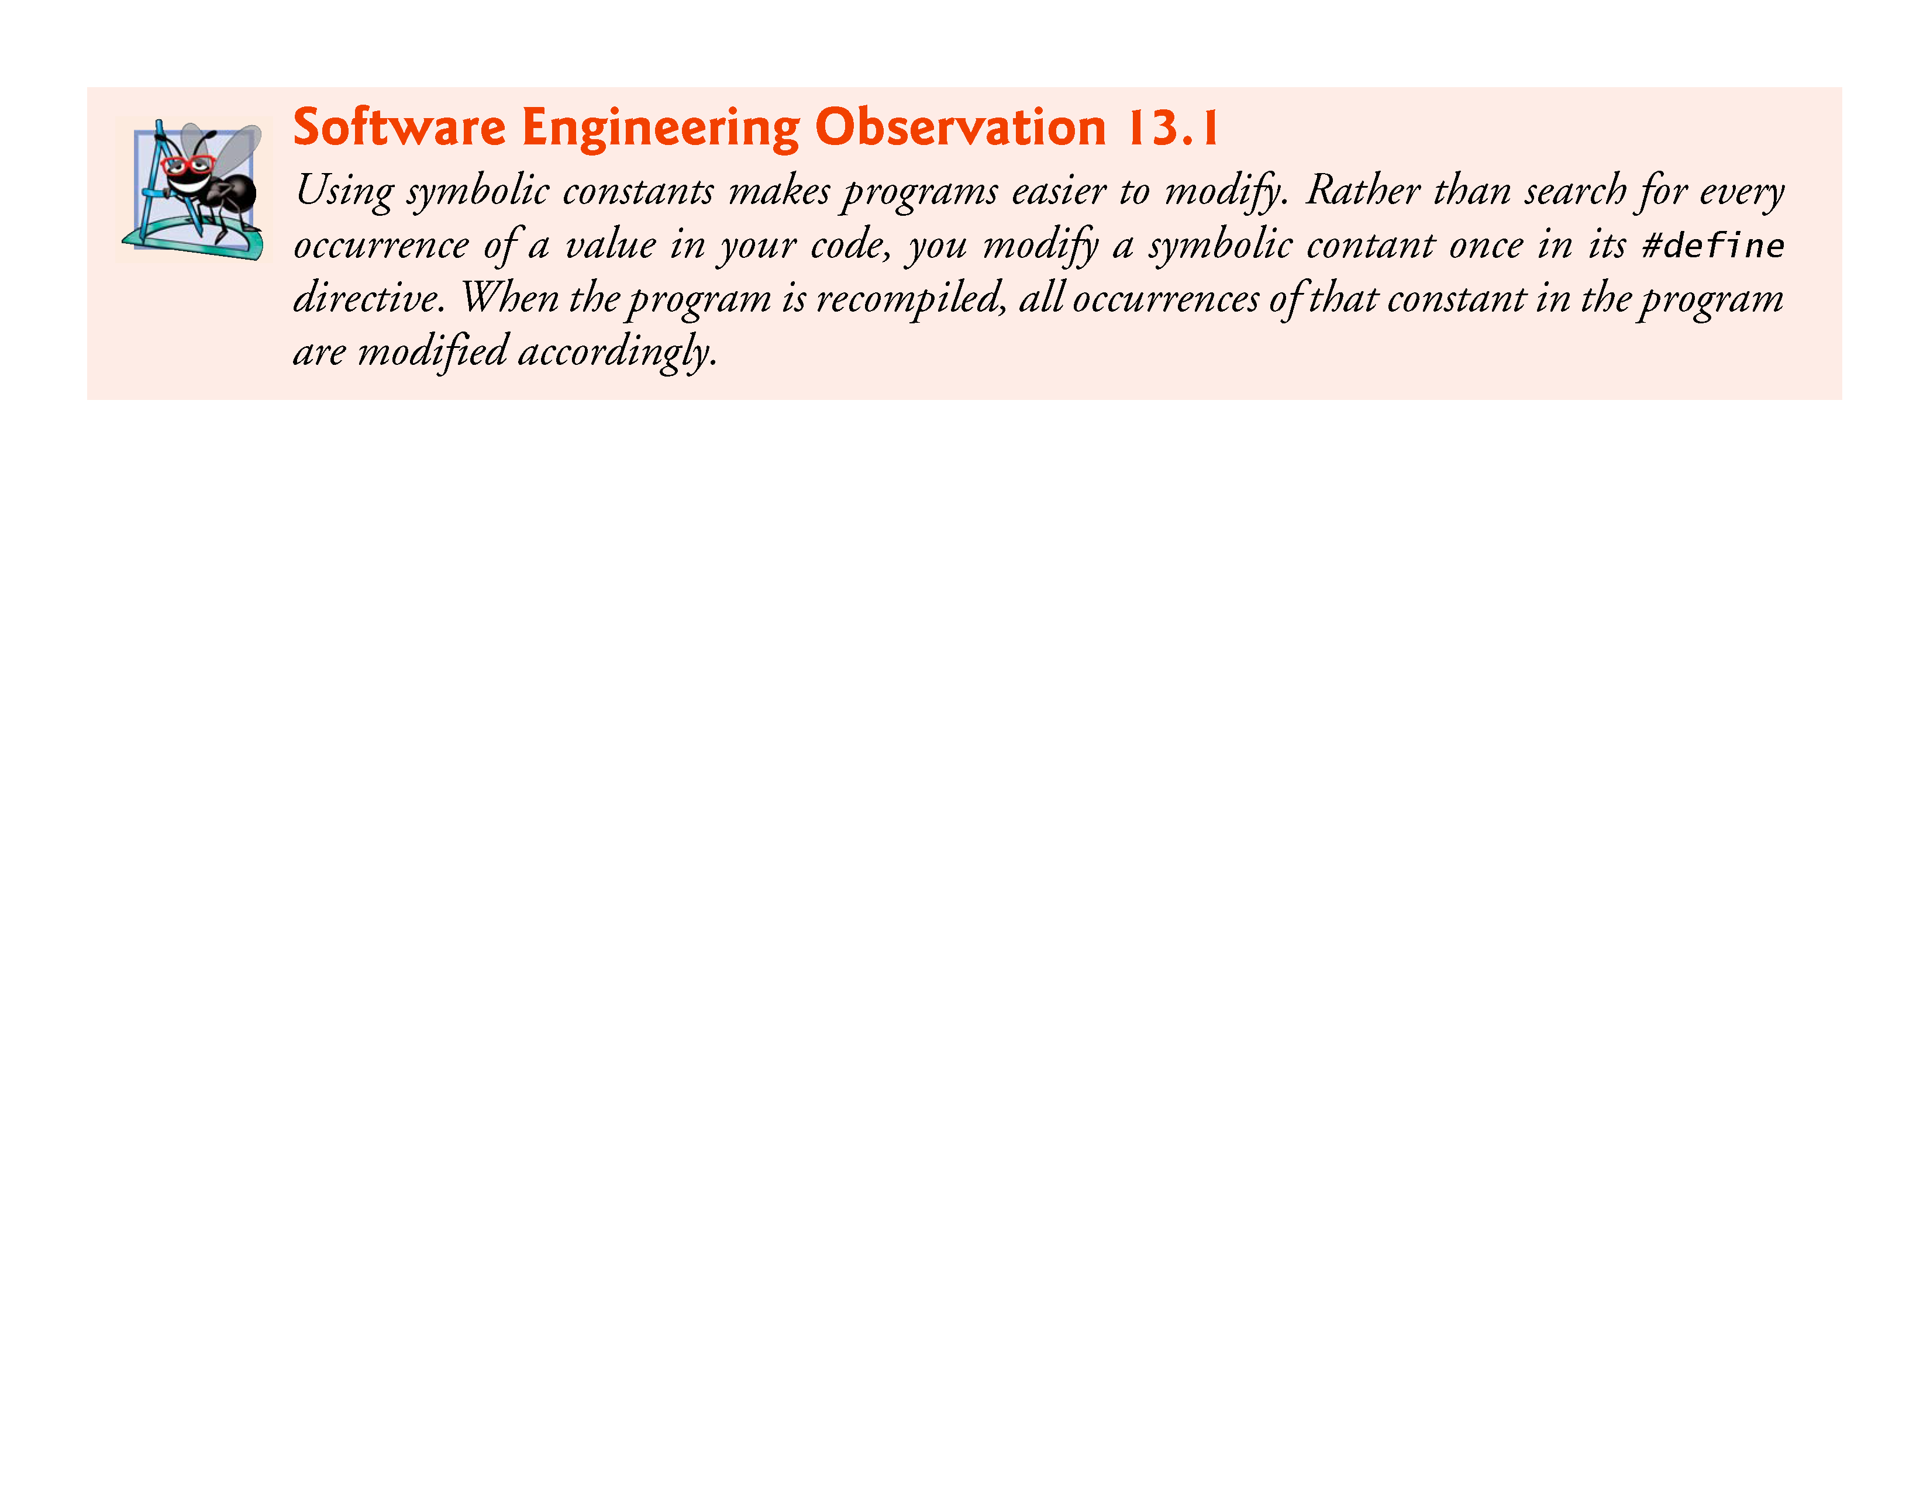

Slide 12
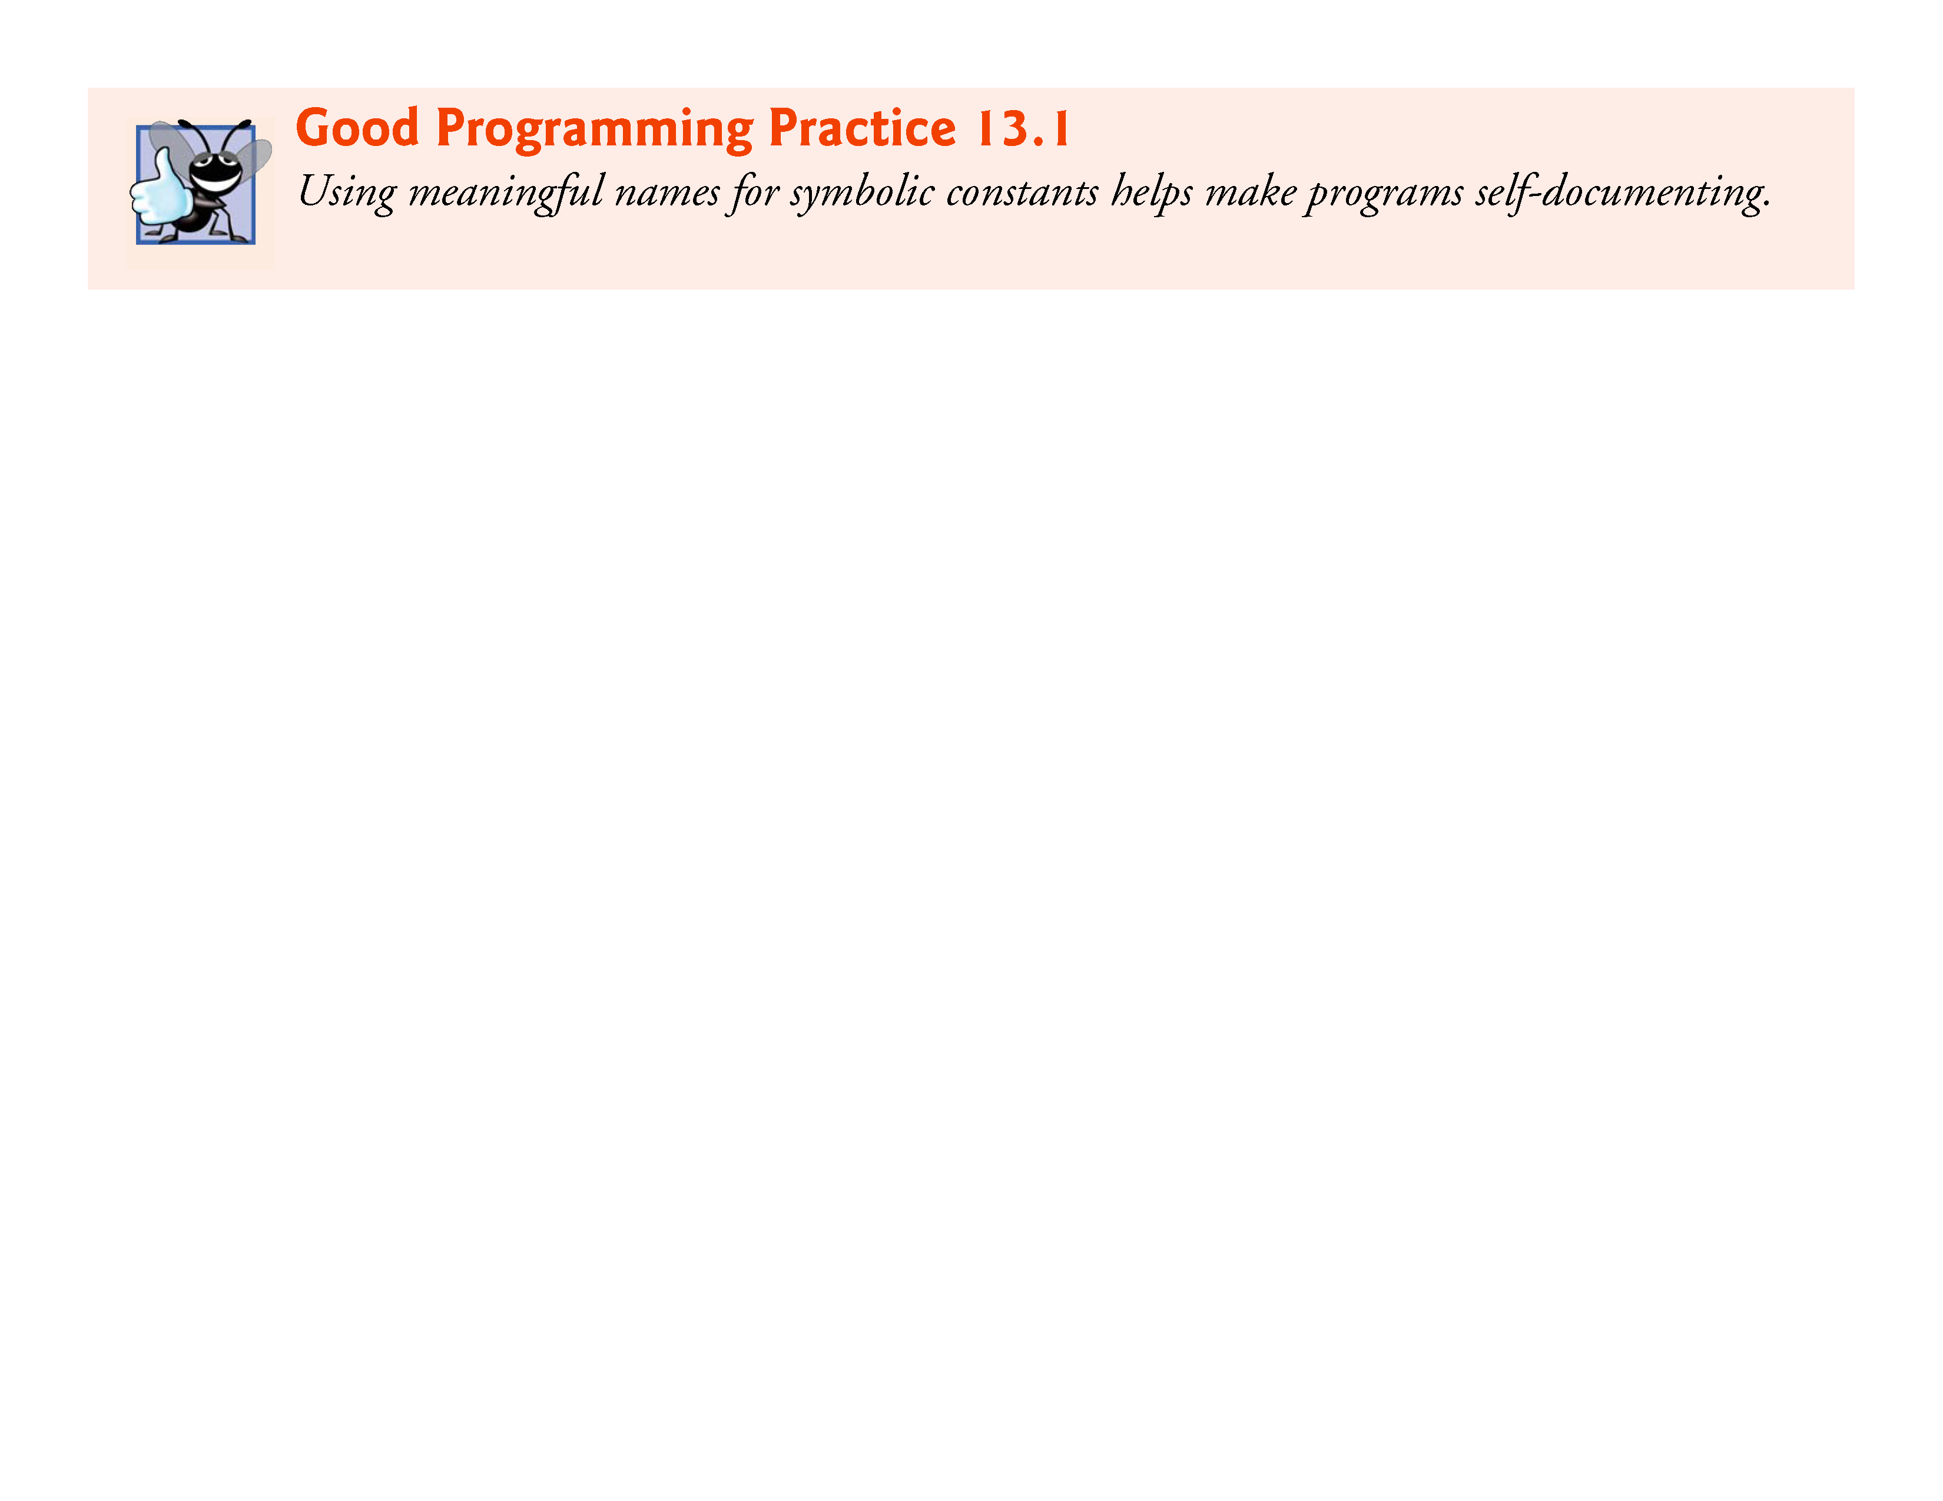

Slide 13
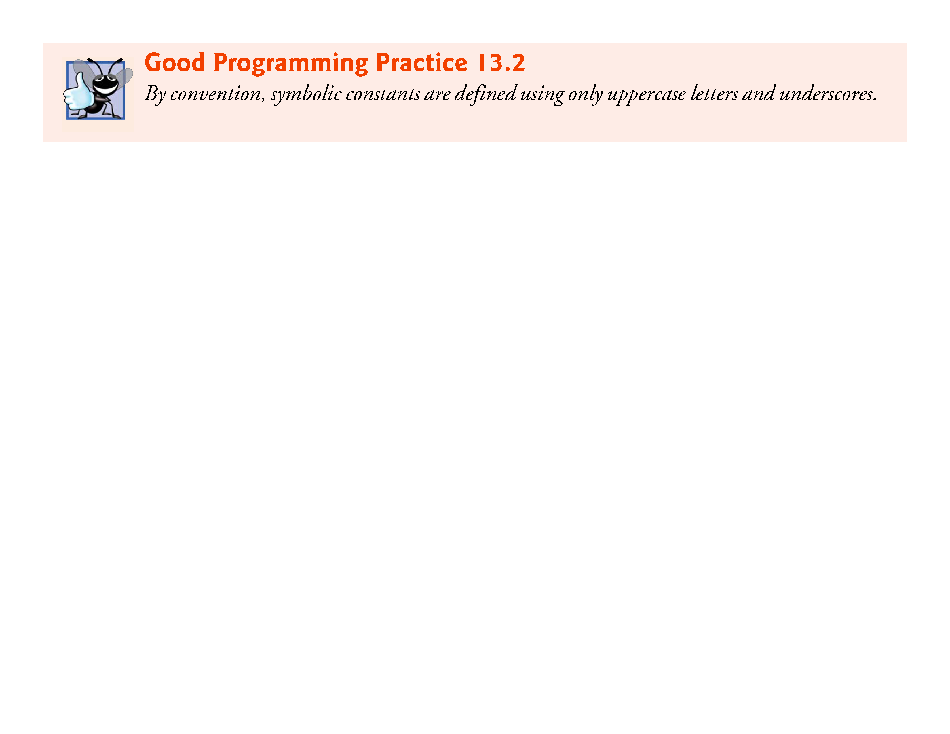

Slide 14
13.4 #define Preprocessor Directive: Macros
A macro is an identifier defined in a #define preprocessor directive.
As with symbolic constants, the macro-identifier is replaced in the program with the replacement-text before the program is compiled.
Macros may be defined with or without arguments.
A macro without arguments is processed like a symbolic constant.
In a macro with arguments, the arguments are substituted in the replacement text, then the macro is expanded—i.e., the replacement-text replaces the identifier and argument list in the program.

Slide 15
13.4 #define Preprocessor Directive: Macros (Cont.)
[Note: A symbolic constant is a type of macro.]
Consider the following macro definition with one argument for the area of a circle:
#define CIRCLE_AREA(x) ((PI) * (x) * (x))
Wherever CIRCLE_AREA(y) appears in the file, the value of y is substituted for x in the replacement-text, the symbolic constant PI is replaced by its value (defined previously) and the macro is expanded in the program.

Slide 16
13.4 #define Preprocessor Directive: Macros (Cont.)
For example, the statement
area = CIRCLE_AREA(4);
is expanded to
area = ((3.14159) * (4) * (4));
then, at compile time, the value of the expression is evaluated and assigned to variable area.
The parentheses around each x in the replacement text force the proper order of evaluation when the macro argument is an expression.

Slide 17
13.4 #define Preprocessor Directive: Macros (Cont.)
For example, the statement
area = CIRCLE_AREA(c + 2);
is expanded to
area = ((3.14159) * (c + 2) * (c + 2));
which evaluates correctly because the parentheses force the proper order of evaluation.

Slide 18
13.4 #define Preprocessor Directive: Macros (Cont.)
If the parentheses in the macro definition are omitted, the macro expansion is
area = 3.14159 * c + 2 * c + 2;
which evaluates incorrectly as
area = (3.14159 * c) + (2 * c) + 2;
because of the rules of operator precedence.

Slide 19
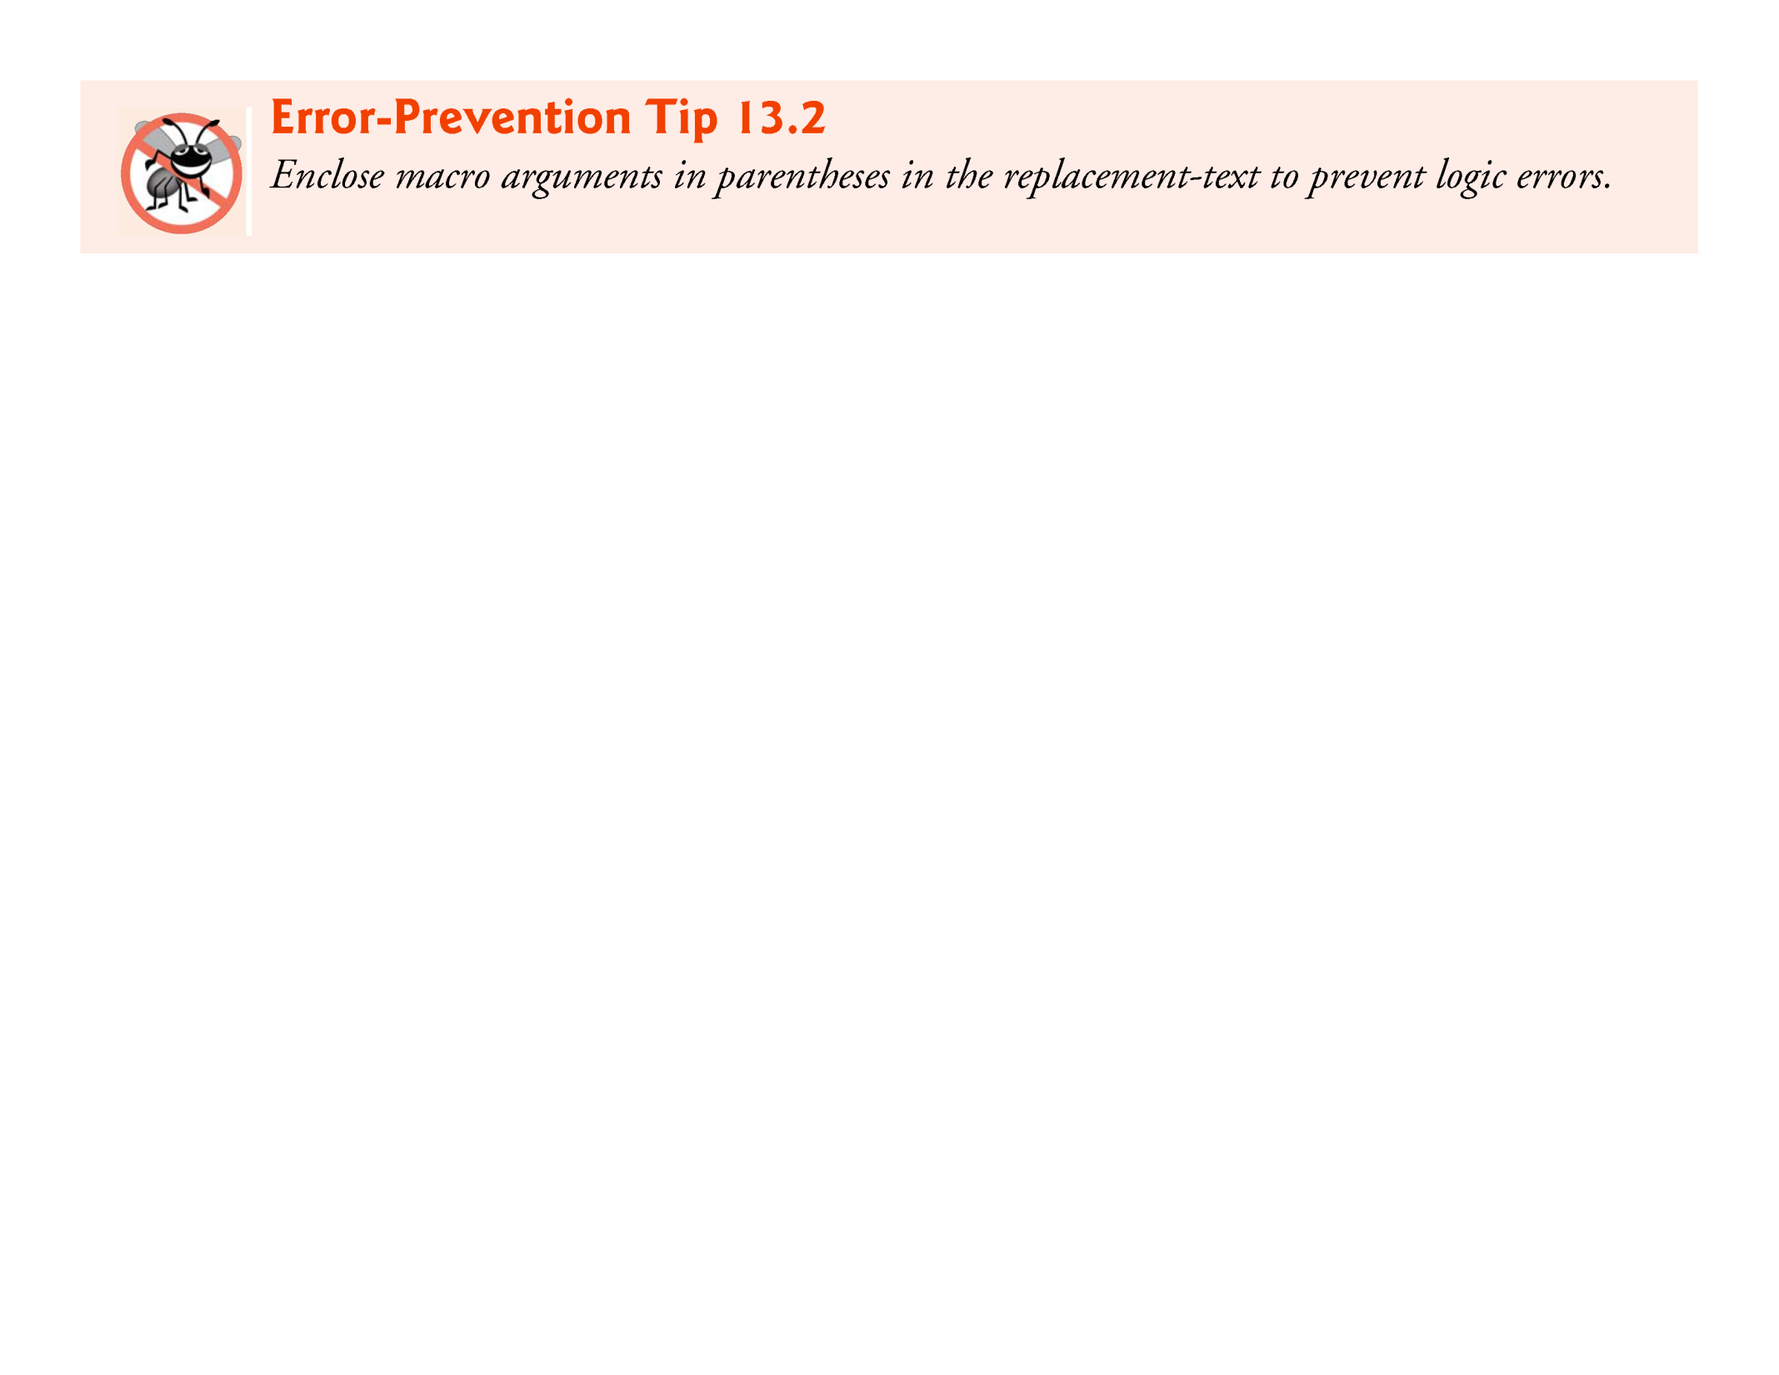

Slide 20
13.4 #define Preprocessor Directive: Macros (Cont.)
Macro CIRCLE_AREA could be defined more safely as a function.
Function circleArea
double circleArea(double x) { return 3.14159 * x * x; }
performs the same calculation as macro CIRCLE_AREA, but the function’s argument is evaluated only once when the function is called.

Slide 21
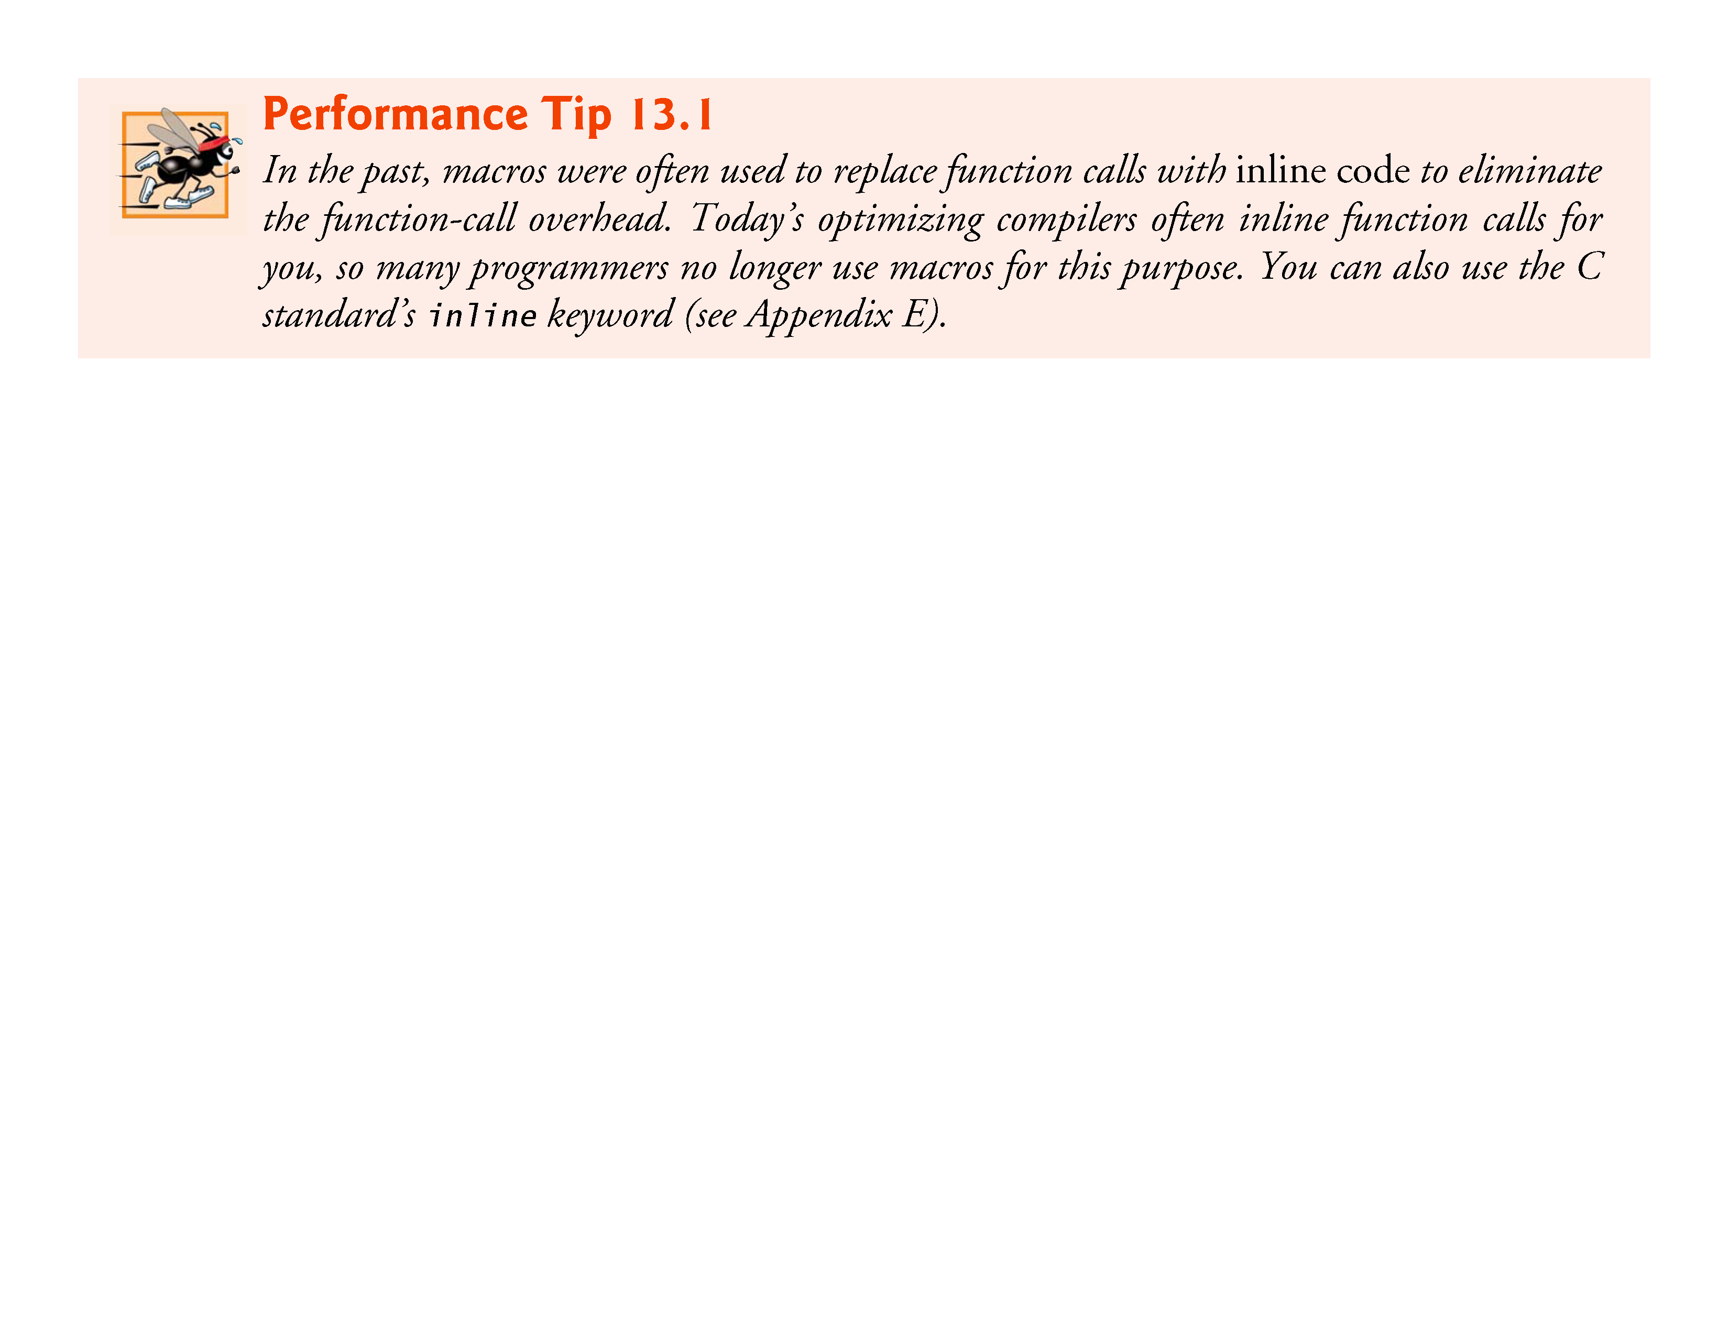

Slide 22
13.4 #define Preprocessor Directive: Macros (Cont.)
The following is a macro definition with two arguments for the area of a rectangle:
#define RECTANGLE_AREA(x, y) ((x) * (y))
Wherever RECTANGLE_AREA(x, y) appears in the program, the values of x and y are substituted in the macro replacement text and the macro is expanded in place of the macro name.
For example, the statement
rectArea = RECTANGLE_AREA(a + 4, b + 7);
is expanded to
rectArea = ((a + 4) * (b + 7));

Slide 23
13.4 #define Preprocessor Directive: Macros (Cont.)
The value of the expression is evaluated at runtime and assigned to variable rectArea.
The replacement text for a macro or symbolic constant is normally any text on the line after the identifier in the #define directive.
If the replacement text for a macro or symbolic constant is longer than the remainder of the line, a backslash (\) must be placed at the end of the line, indicating that the replacement text continues on the next line.

Slide 24
13.4 #define Preprocessor Directive: Macros (Cont.)
Symbolic constants and macros can be discarded by using the #undef preprocessor directive.
Directive #undef “undefines” a symbolic constant or macro name.
The scope of a symbolic constant or macro is from its definition until it’s undefined with #undef, or until the end of the file.
Once undefined, a name can be redefined with #define.
Functions in the standard library sometimes are defined as macros based on other library functions.

Slide 25
13.4 #define Preprocessor Directive: Macros (Cont.)
A macro commonly defined in the <stdio.h> header is
#define getchar() getc(stdin)
The macro definition of getchar uses function getc to get one character from the standard input stream.
Function putchar of the <stdio.h> header and the character handling functions of the <ctype.h> header often are implemented as macros as well.
Expressions with side effects (i.e., variable values are modified) should not be passed to a macro because macro arguments may be evaluated more than once.

Slide 26
13.5 Conditional Compilation
Conditional compilation enables you to control the execution of preprocessor directives and the compilation of program code.
Each conditional preprocessor directive evaluates a constant integer expression.
Cast expressions, sizeof expressions and enumeration constants cannot be evaluated in preprocessor directives.
The conditional preprocessor construct is much like the if selection statement.

Slide 27
13.5 Conditional Compilation (Cont.)
Consider the following preprocessor code:
#if !defined(MY_CONSTANT) #define MY_CONSTANT 0 #endif
Which determines whether MY_CONSTANT is defined—that is, whether MY_CONSTANT has already appeared in an earlier #define directive.
The expression defined(MY_CONSTANT) evaluates to 1 if MY_CONSTANT is defined and 0 otherwise.
If the result is 0, !defined(MY_CONSTANT) evaluates to 1 and MY_CONSTANT is defined.
Otherwise, the #define directive is skipped.

Slide 28
13.5 Conditional Compilation (Cont.)
Every #if construct ends with #endif.
Directives #ifdef and #ifndef are shorthand for #if defined(name) and #if !defined(name).
A multiple-part conditional preprocessor construct may be tested by using the #elif (the equivalent of else if in an if statement) and the #else (the equivalent of else in an if statement) directives.
These directives are frequently used to prevent header files from being included multiple times in the same source file.
We use this technique extensively in the C++ part of this book.

Slide 29
13.5 Conditional Compilation (Cont.)
During program development, it’s often helpful to “comment out” portions of code to prevent them from being compiled.
If the code contains multiline comments, /* and */ cannot be used to accomplish this task, because such comments cannot be nested.
Instead, you can use the following preprocessor construct:
#if 0 code prevented from compiling #endif
To enable the code to be compiled, replace the 0 in the preceding construct with 1.

Slide 30
13.5 Conditional Compilation (Cont.)
Conditional compilation is commonly used as a debugging aid.
Many C implementations include debuggers, which provide much more powerful features than conditional compilation.
If a debugger is not available, printf statements are often used to print variable values and to confirm the flow of control.
These printf statements can be enclosed in conditional preprocessor directives so the statements are compiled only while the debugging process is not completed.

Slide 31
13.5 Conditional Compilation (Cont.)
For example,
#ifdef DEBUG printf("Variable x = %d\n", x); #endif
causes a printf statement to be compiled in the program if the symbolic constant DEBUG has been defined (#define DEBUG) before directive #ifdef DEBUG.

Slide 32
13.5 Conditional Compilation (Cont.)
When debugging is completed, the #define directive is removed from the source file (or commented out) and the printf statements inserted for debugging purposes are ignored during compilation.
In larger programs, it may be desirable to define several different symbolic constants that control the conditional compilation in separate sections of the source file.
Many compilers allow you to define and undefine symbolic constants with a compiler flag so that you do not need to change the code.

Slide 33
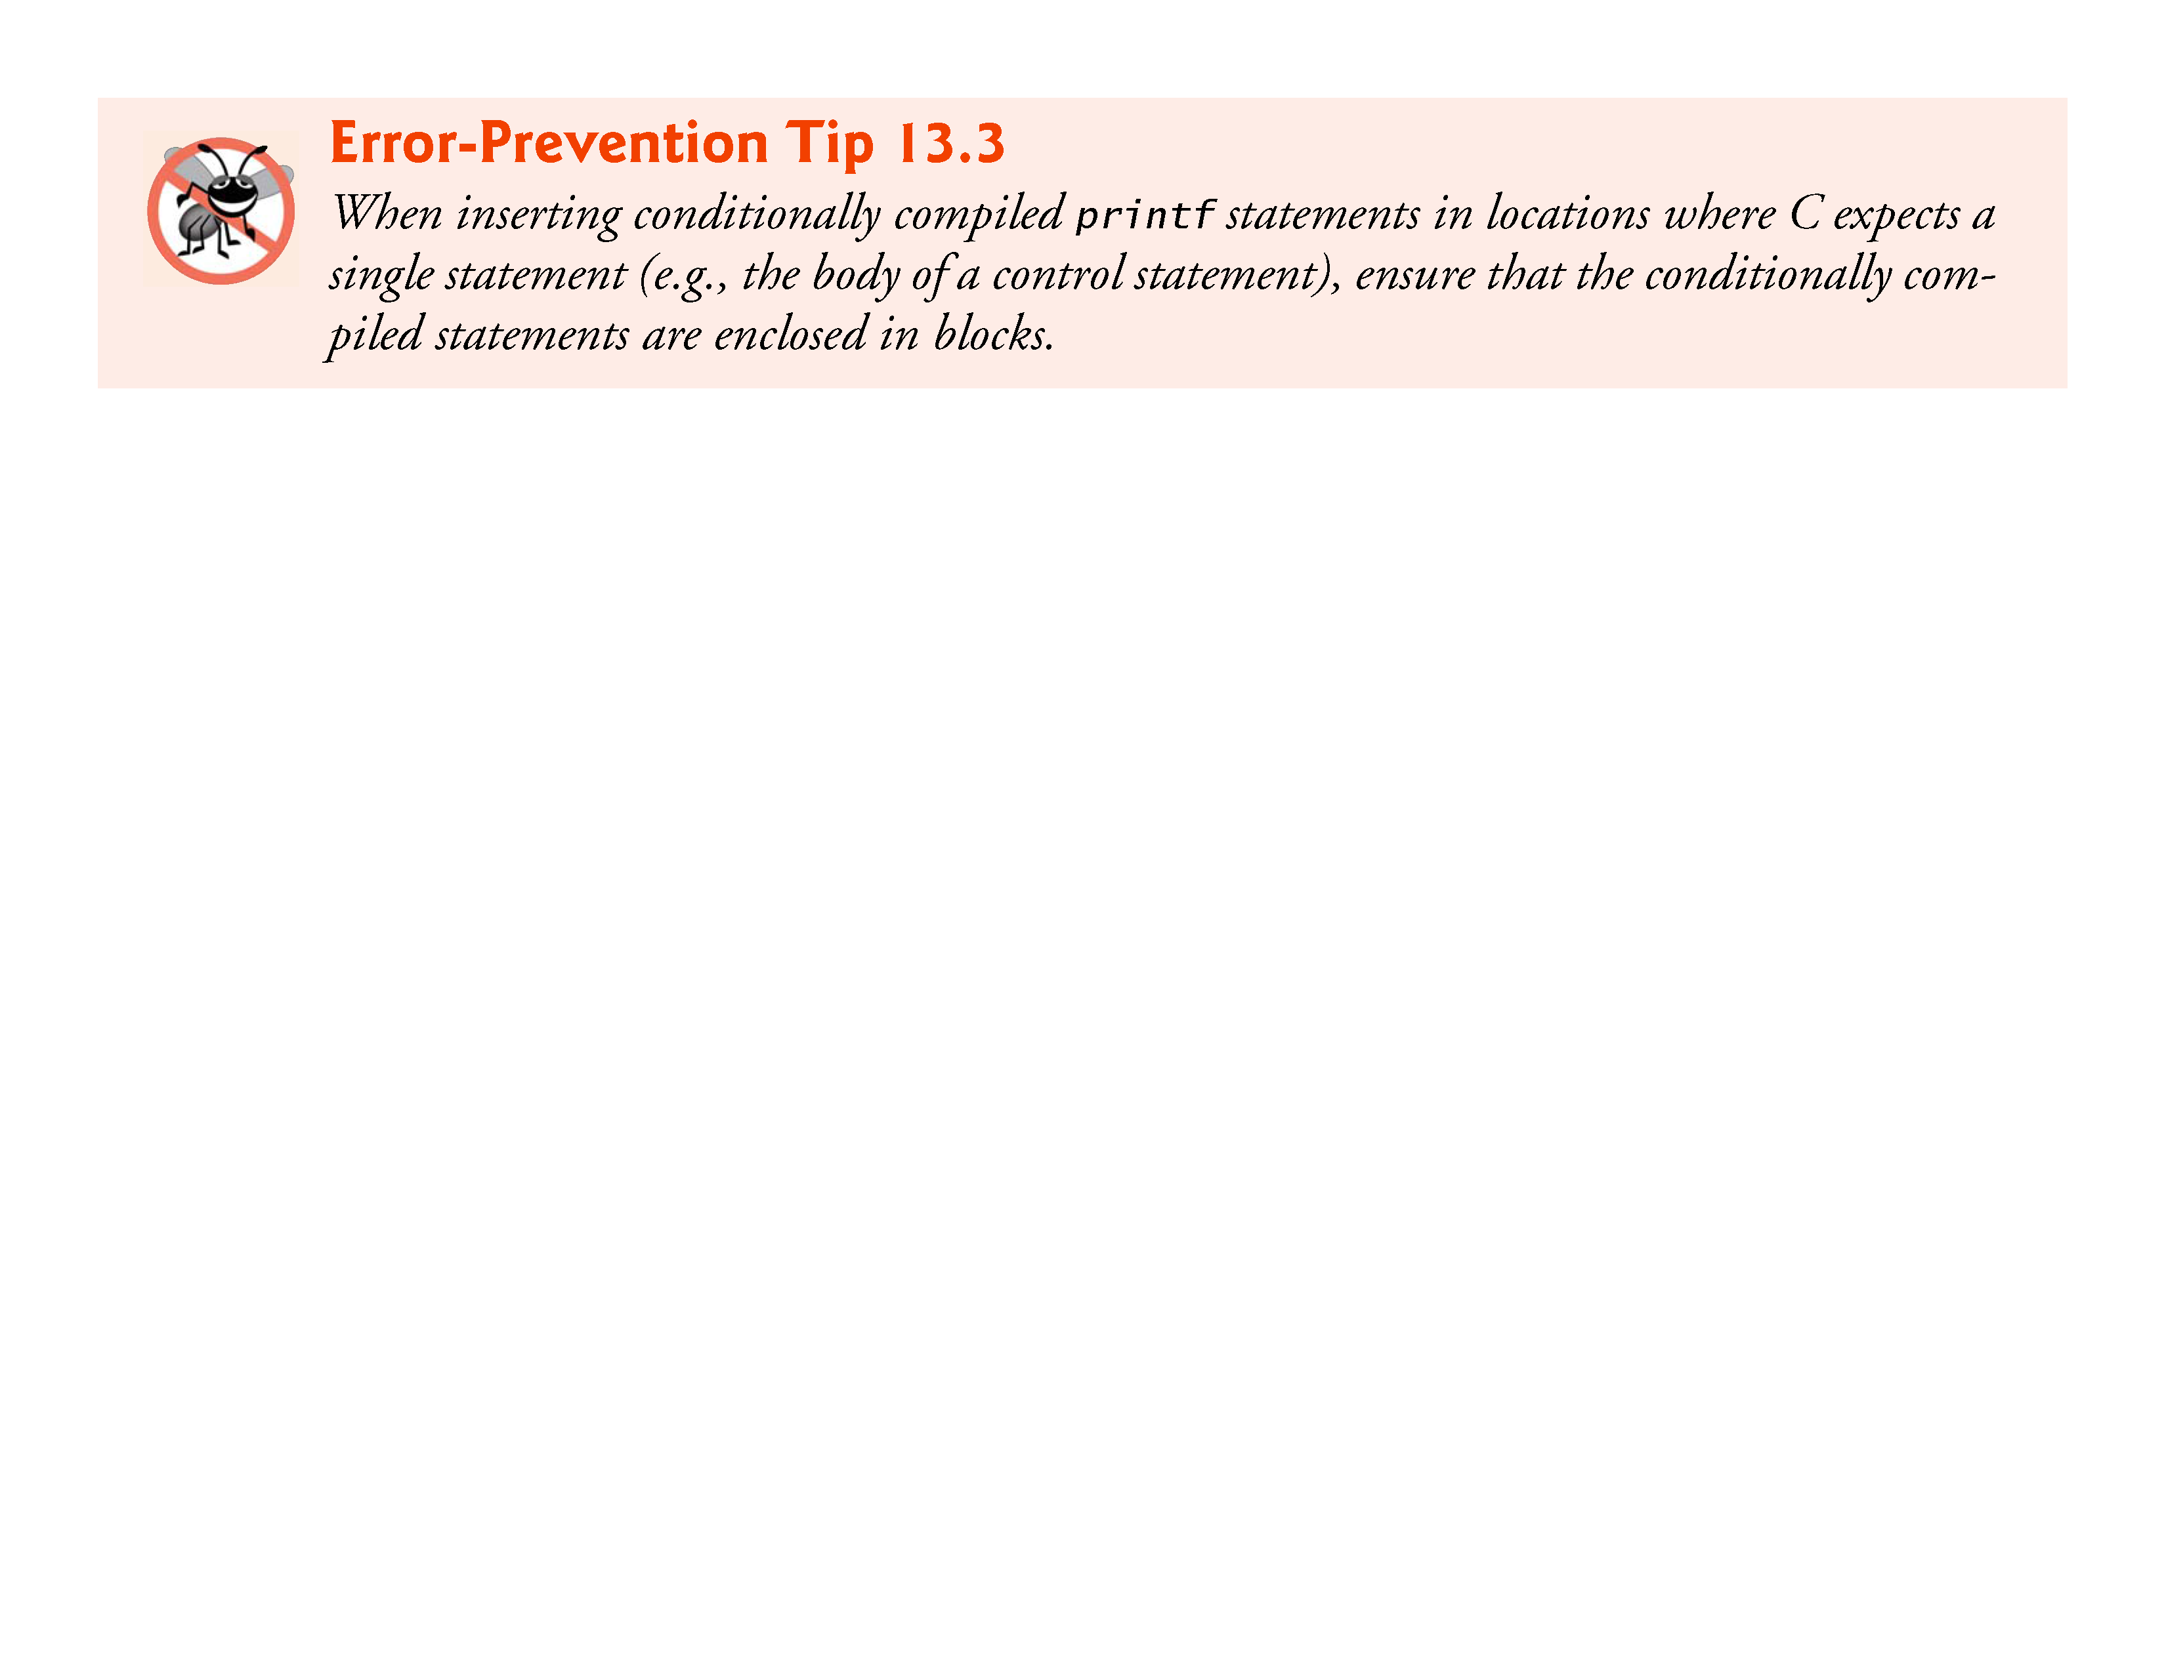

Slide 34
13.6 #error and #pragma Preprocessor Directives
The #error directive
#error tokens
prints an implementation-dependent message including the tokens specified in the directive.
The tokens are sequences of characters separated by spaces.
For example,
#error 1 - Out of range error
contains 6 tokens.
When a #error directive is processed on some systems, the tokens in the directive are displayed as an error message, preprocessing stops and the program does not compile.

Slide 35
13.8 Line Numbers
The #line preprocessor directive causes the subsequent source code lines to be renumbered starting with the specified constant integer value.
The directive
#line 100
starts line numbering from 100 beginning with the next source code line.
A filename can be included in the #line directive.

Slide 36
13.8 Line Numbers (Cont.)
The directive
#line 100 "file1.c"
indicates that lines are numbered from 100 beginning with the next source code line and that the name of the file for the purpose of any compiler messages is "file1.c".
The directive normally is used to help make the messages produced by syntax errors and compiler warnings more meaningful.
The line numbers do not appear in the source file.

Slide 37
13.9 Predefined Symbolic Constants
Standard C provides predefined symbolic constants, several of which are shown in Fig. 13.1——the rest are in Section 6.10.8 of the C standard document.
The identifiers for each of the predefined symbolic constants begin and end with two underscores.
These identifiers and the defined identifier (used in Section 13.5) cannot be used in #define or #undef directives.

Slide 38
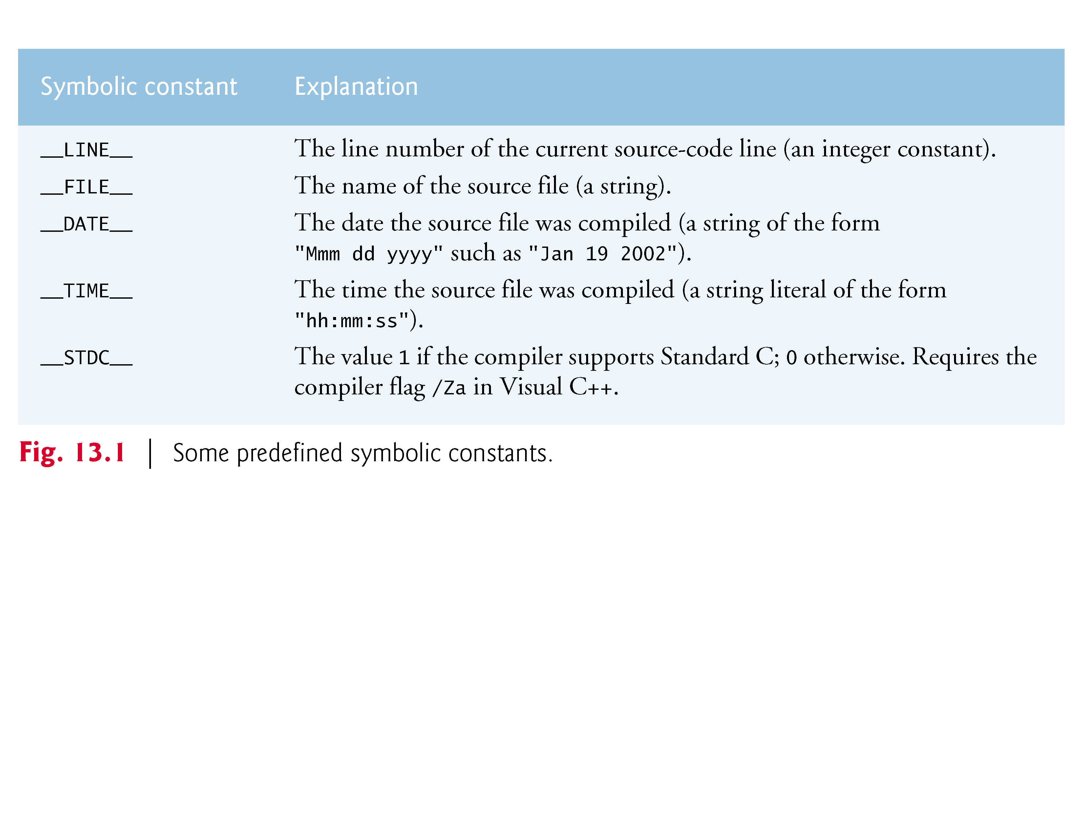

Slide 39
13.10 Assertions
The assert macro—defined in the <assert.h> header—tests the value of an expression at execution time.
If the value of the expression is false (0), assert prints an error message and calls function abort (of the general utilities library—<stdlib.h>) to terminate program execution.
This is a useful debugging tool for testing whether a variable has a correct value.
For example, suppose variable x should never be larger than 10 in a program.

Slide 40
13.10 Assertions (Cont.)
An assertion may be used to test the value of x and print an error message if the value of x is incorrect.
The statement would be
assert(x <= 10);
If x is greater than 10 when the preceding statement is encountered in a program, an error message containing the line number and filename is printed and the program terminates.

Slide 41
13.10 Assertions (Cont.)
You may then concentrate on this area of the code to find the error.
If the symbolic constant NDEBUG is defined, subsequent assertions will be ignored.
Thus, when assertions are no longer needed, the line
#define NDEBUG
is inserted in the program file rather than each assertion being deleted manually.

Slide 42
